Slide 1
Parallel Computation for Matrix Multiplication
Presented By: Dima Ayash
Kelwin Payares
Tala Najem

Slide 2
Matrix Multiplication
Matrix operations, like matrix multiplication, are commonly used in almost all areas of scientific research.
Applications of matrix multiplication in computational problems are found in many fields including scientific computing and pattern recognition and in seemingly unrelated problems such counting the paths through a graph (graph theory), signal processing, digital control and is such a central operation in many numerical algorithms .
Many different algorithms have been designed for multiplying matrices on different types of hardware, including parallel and distributed systems, where the computational work is spread over multiple processors (perhaps over a network).

Slide 3
C = A × B... MATH
Let A and B be matrices of size n × m and m × l, respectively. The product matrix C = A * B is an n × l matrix, for which elements are defined as follows:
$\text{c}\text{ij}=\sum_{k=0}^{m−1}{\text{a}\text{ik}\text{ . }\text{b}\text{kj} }$ where 0 ≤i < n, 0 ≤ j < l

Slide 4
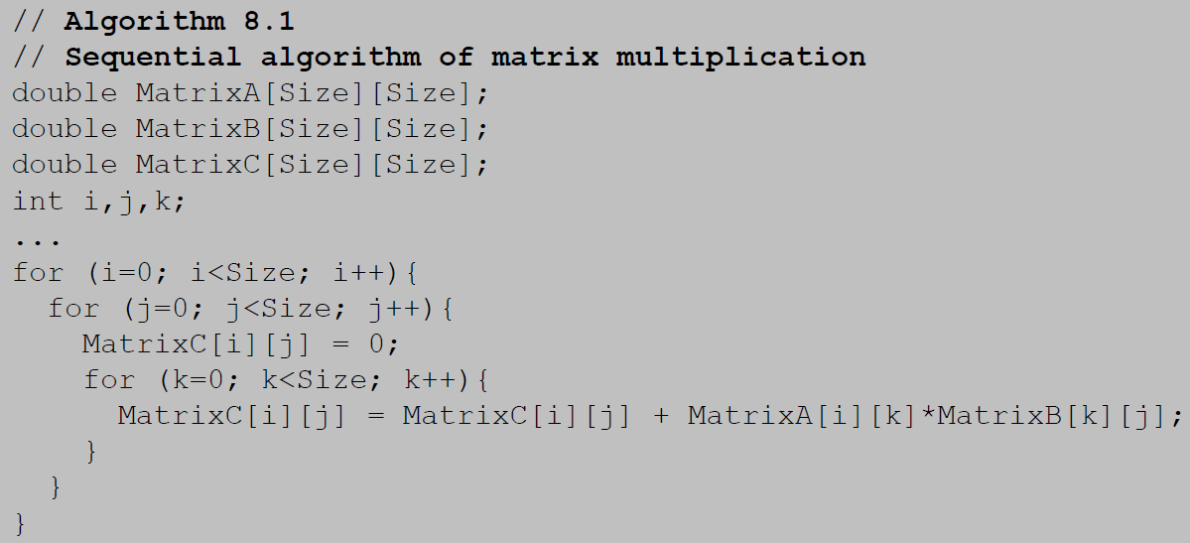
Sequential Algorithm

Slide 5
Sequential Algorithm
The previous algorithm performs the matrix C rows calculation sequentially
At every iteration of the outer loop on i variable a single row of matrix A and all columns of matrix B are processed
× =
We can see that there are m·l inner products calculated to perform the matrix multiplication
The complexity of the matrix multiplication is O(mnl) & assuming that n=m=l ➔ O($n^{3}$).
A
B
C

Slide 6
Partitioning into Submatrices
Matrix is divided into S² submatrices. Each submatrix has n/s × n/s elements. Using the notation A_{p,q} as the sbmatrix in submatrix row p and submatrix column q:
For (p=0; p<s; p++)
For (q=0; q<s; q++){
C_{p,q}=0; /*clear elements of sumbatrix*/
For (r=0; r<m ; r++) /*submatrix multiplication and add to accumulating submatrix*/
C_{p,q}= C_{p,q} + A_{p,r} * B_{r,q}; }
The line: C_{p,q}= C_{p,q} + A_{p,r} * B_{r,q} means multiply submatrix A_{p,r} and B_{r,q} using matrix multiplication and add to submatrix C_{p,q} using matrix addition.

Slide 7
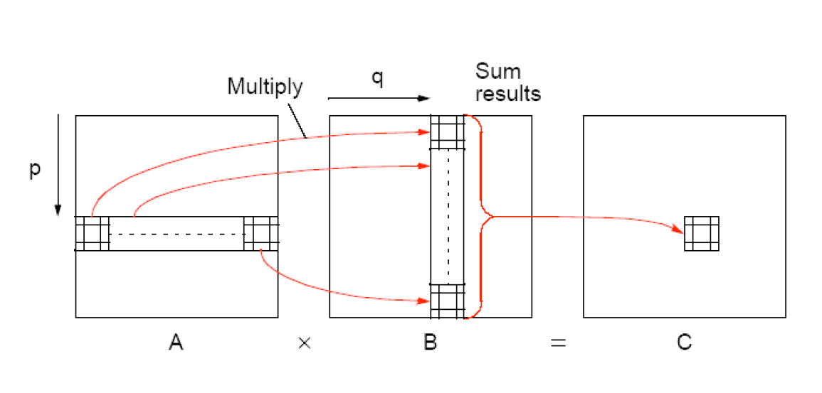
Partitioning into Submatrices -cont

Slide 8
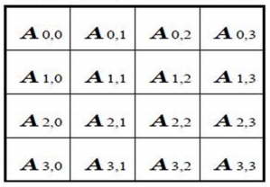
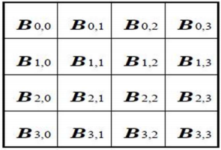
Cannon Algorithm
This is a memory efficient algorithm.
Both n matrices A & B are partitioned among P processors.
A
B

Slide 9
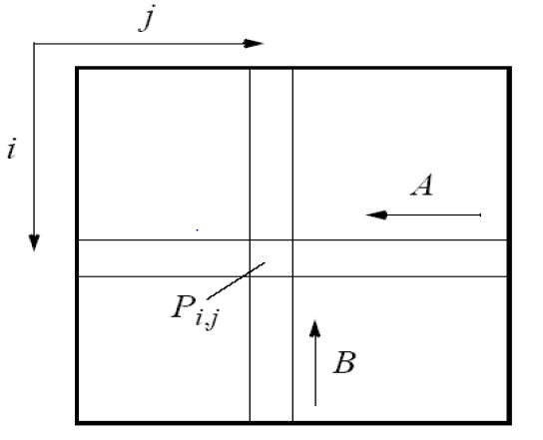
Cannon Algorithm –Cont.
Initially processor P_{i,j} has elements a_{i,j} and b_{i,j} (0 ≤ I < n, 0 ≤ j < n)

Slide 10
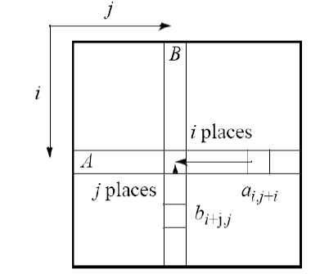
Cannon Algorithm –Cont.
Elements are moved from their initial position to an aligned position. The complete i^{th} row of A is shifted i places left and the complete j^{th} column of B is shifted j places upward.

Slide 11
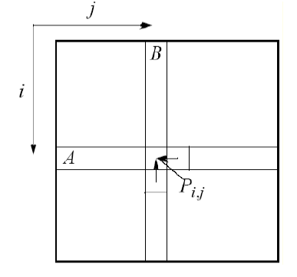
Cannon Algorithm –Cont.
Each processor P_{i,j} multiply its elements.
The i^{th} row of A is shifted one place left, and the j^{th} column of B is shifted one place upward.

Slide 12
Cannon Algorithm –Cont.
Each processor P_{i,j} multiplies its elements brought to it and adds the results to the accumulating sum.
Step 4 and 5 are repeated until the final result is obtained (n-1 shifts with n rows and n columns of elements).

Slide 13
Cannon Algorithm –Cont.
Initially the matrix A | Initially the matrix B
Row 0 is unchanged. | Column 0 is unchanged.
Row 1 is shifted 1 place left. | Column 1 is shifted one place up.
Row 2 is shifted 2 places left. | Column 2 is shifted 2 places up.
Row 3 is shifted 3 places left. | Column 3 is shifted 3 places up.

Slide 14
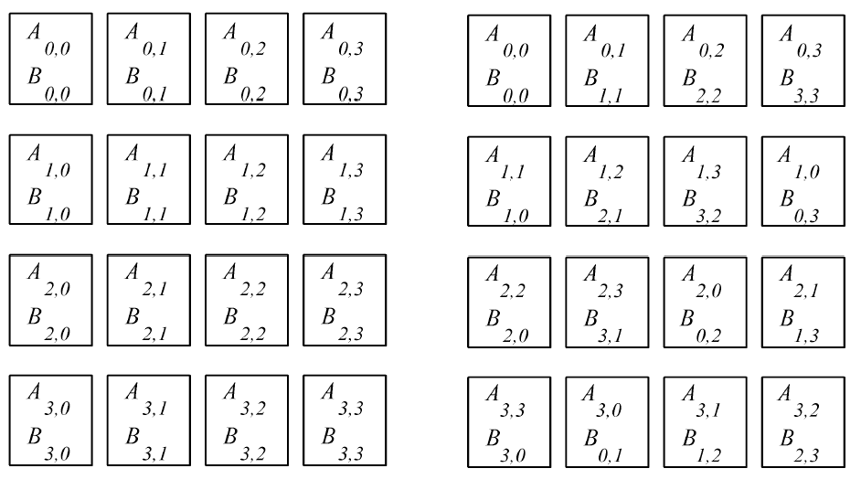
Cannon Algorithm –Cont.

Slide 15
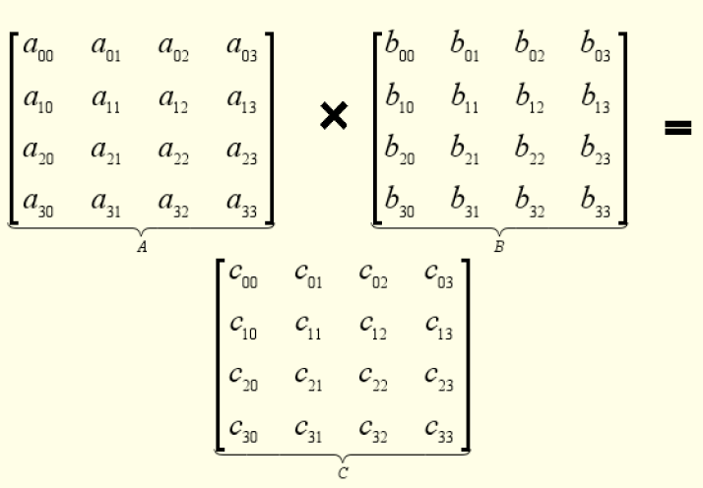
Cannon Algorithm –Cont.

Slide 16
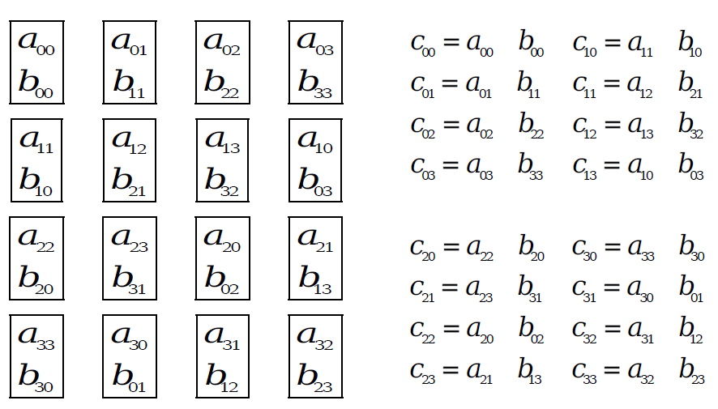
Cannon Algorithm – Step 1

Slide 17
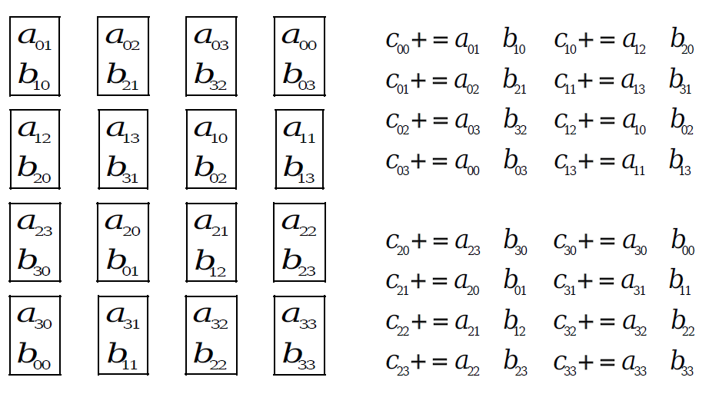
Cannon Algorithm – Step 2

Slide 18
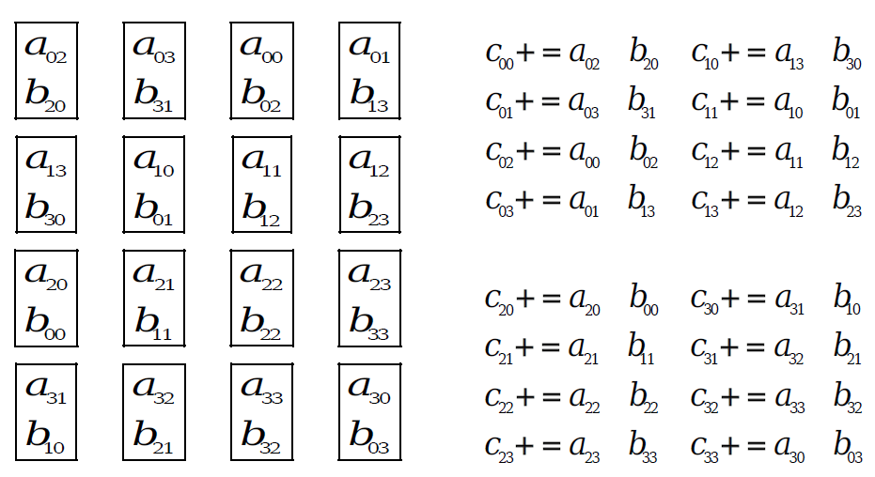
Cannon Algorithm – Step 3

Slide 19
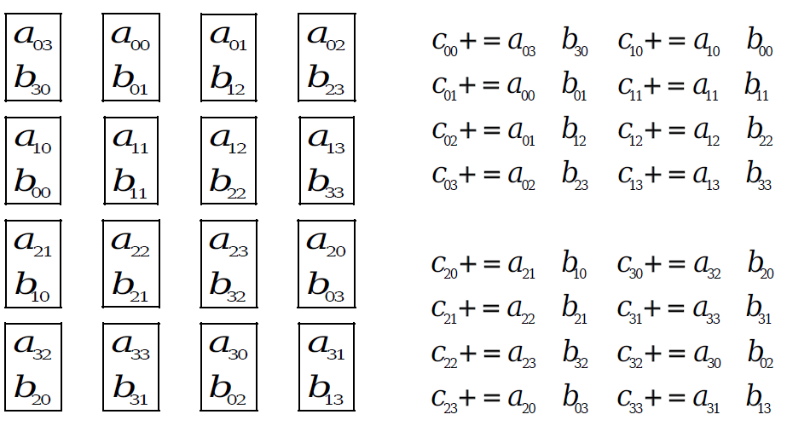
Cannon Algorithm – Step 4

Slide 20
Fox Algorithm
Both n matrices A & B are partitioned among P processors so that each processor initially stores $\left(\frac{n}{\sqrt{p}}\right)×\left(\frac{n}{\sqrt{p}}\right)$
The algorithm uses one to all broadcasts of the blocks of matrix A in processor rows, and single-step circular upwards shifts of the blocks of matrix B along processor columns.
Initially, each diagonal block A_{i,i} is selected for broadcast .

Slide 21
Fox Algorithm –Cont.
Repeated $\sqrt{p}$ times:
Broadcast A_{i,i} to all processors in the row.
Multiply block of A received with resident block of B
Send the block of B up one step (with wraparound)
Select block A_{i,(j+1)mod}$\sqrt{p}$ (where A_{i,j} is the block broadcast in the previous step) and broadcast to all processors in row.
Got to 2.

Slide 22
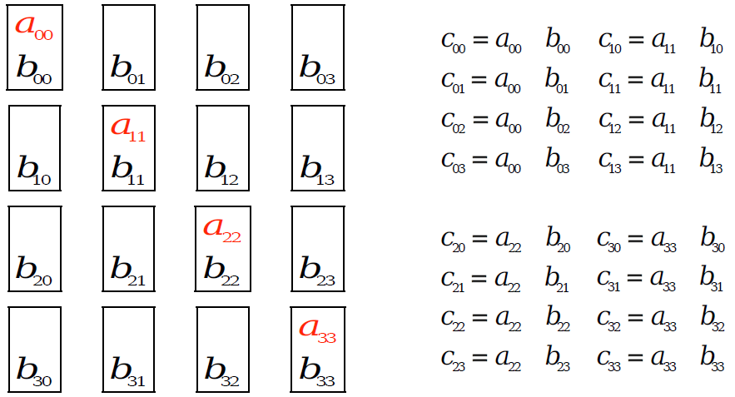
Fox Algorithm –Step 1
Initially broadcast the diagonal elements of A

Slide 23
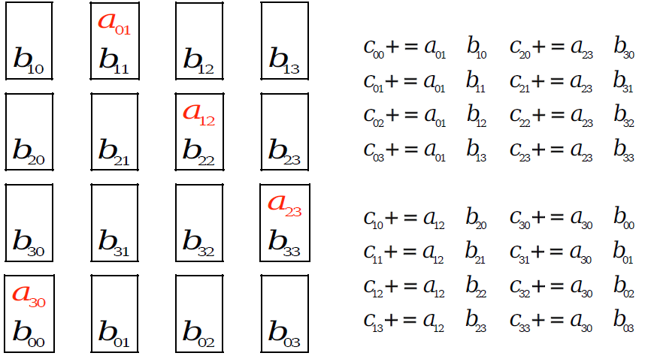
Fox Algorithm –Step 2
Broadcast the next element of A in rows, shift B in column and perform multiplication

Slide 24
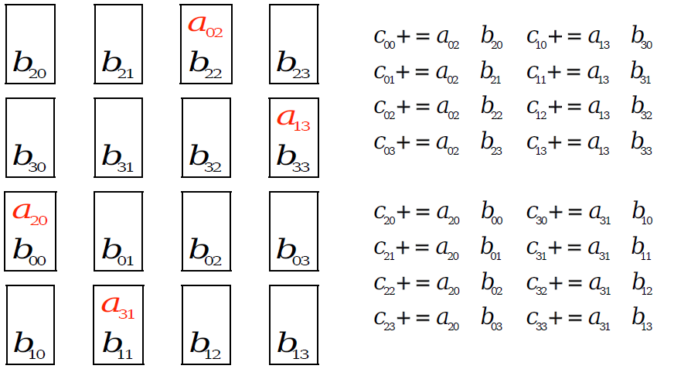
Fox Algorithm –Step 3
Broadcast the next element of A in rows, shift B in column and perform multiplication

Slide 25
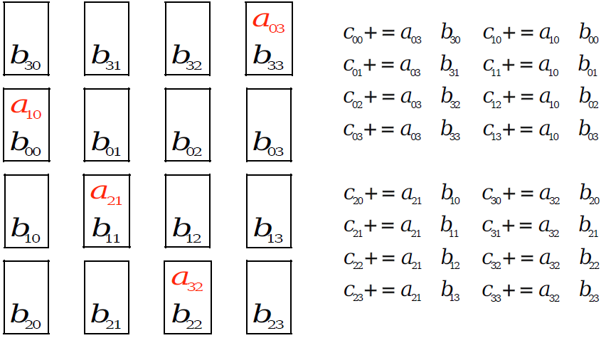
Fox Algorithm –Step 4
Broadcast the next element of A in rows, shift B in column and perform multiplication

Slide 26
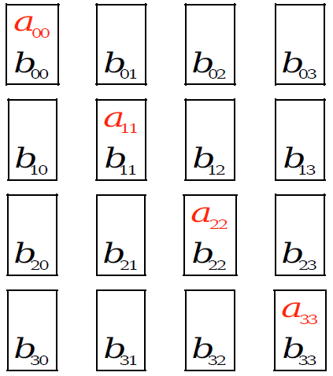
Fox Algorithm –Conclusion
Shifting is over. Stop the iteration.
Conclusion
Fox algorithm is memory efficient method.
Communication overhead is more than Cannon algorithm.

Slide 27
Parallel Algorithm for Dense Matrix Multiplication
Two square matrices A and B of size n that have to be multiplied:
Partition these matrices in square blocks p, where p is the number of processes available.
Create a matrix of processes of size p^{1/2} x p^{1/2} so that each process can maintain a block of A matrix and a block of B matrix.
Each block is sent to each process, and the copied sub blocks are multiplied together and the results added to the partial results in the C sub-blocks.
The A sub-blocks are rolled one step to the left and the B sub-blocks are rolled one step upward.
Repeat steps 3 & 4 ($\sqrt{p}$) times

Slide 28
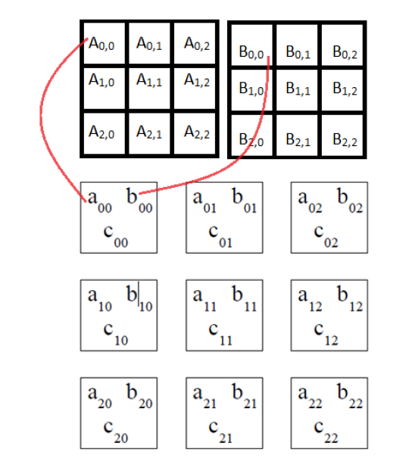
Parallel Algorithm for Dense Matrix Multiplication –Cont.

Slide 29
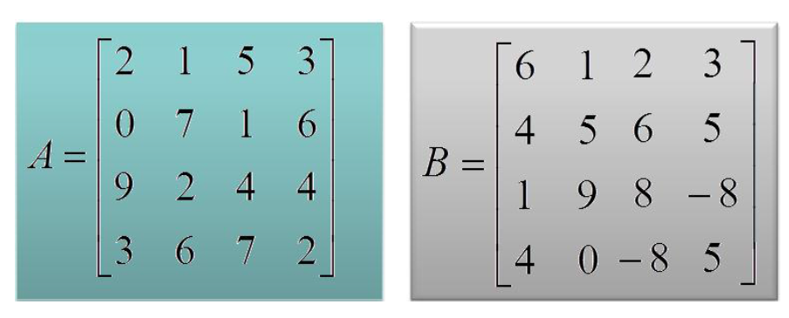
Example
Matrices to be multiplied:

Slide 30
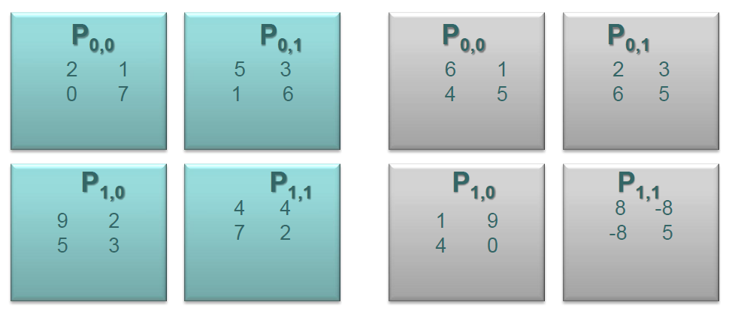
Example –Cont.
These matrices are divided into 4 square blocks as follows:

Slide 31
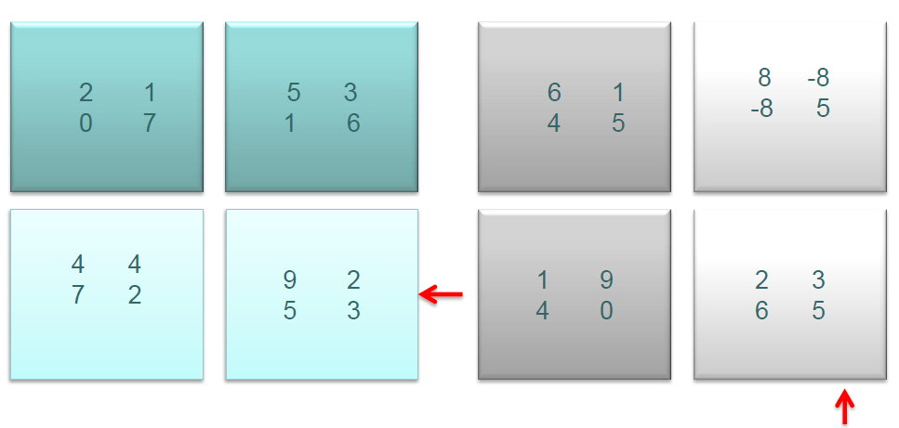
Example –Cont.
Matrices A and B after the initial alignment.

Slide 32
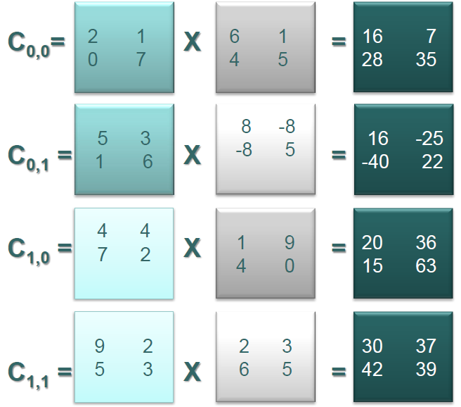
Example –Cont.
Local matrix multiplication

Slide 33
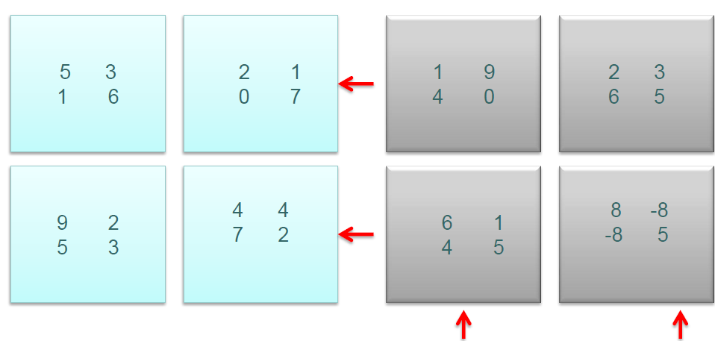
Example –Cont.
Shift A one step to left, shift B one step up

Slide 34
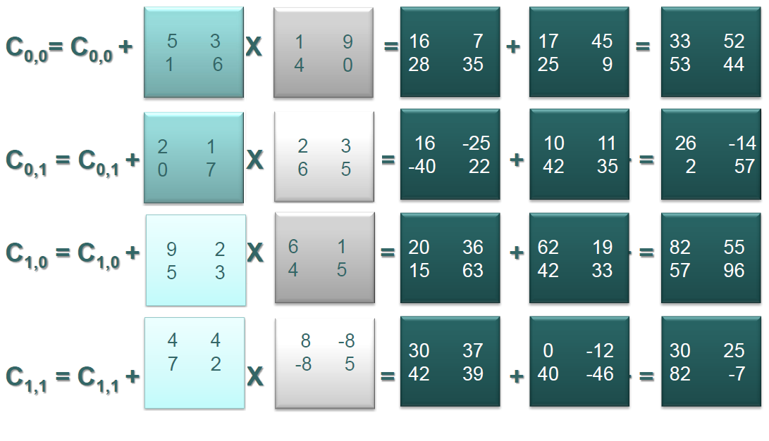
Example –Cont.
Local matrix multiplication.

Slide 35
References
Parallel Computing Chapter 8 Dense Matrix Multiplication, Jun Zhang Department of Computer Science University of Kentucky.
Parallel Programming Application: Matrix Multiplication, UYBHM Yaz Çalıstayı 15 – 26 Haziran 2009.
Parallel Algorithm for Dense Matrix Multiplication; Ortega, Patricia 2012.

Slide 36
Thank you ☺

